Slide 1
. Bare-headed Sikh in the Gurdwara
Can a Sikh come to the Gurdwara bare-headed?”

Slide 2
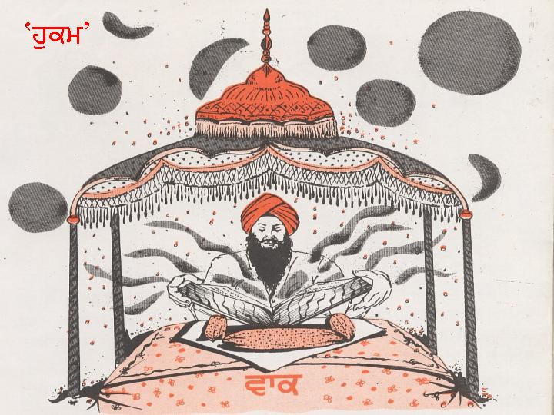
"Where is it written in the Guru Granth Sahib?”
The game-book only states the rules of the game and not the uniform of the team that decides to play that game.
The manager of the team decides the uniform.
Gurbani reveals gurmat, the spiritual lesson, and the philosophy of life to be adopted by a person of any religion or of none.

Slide 3
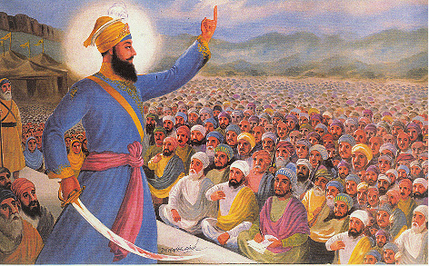
It is not supposed to mention anything about the dress code a devotee of a specific religion should follow.
Guru Gobind Singh decided the dress code for the Sikh faith, and all Sikhs have to accept it.
Anyway, wearing a head cover at sacred functions is a worldwide culture, not just an Indian, or a Sikh culture.

Slide 4
wearing a turban is a practice as old as the written history of humankind.
It was an essential garment in the west also.
The Old Testament mentions the requirement of tying turbans by the devotees

Slide 5
In the so-called advanced western culture, which does not always respect traditional values, a bride at the time of her marriage still feels honored to cover her head and face by a veil.
The requirement of covering one’s head is not peculiar to the Sikh faith; it is an ancient worldwide culture of the civilized people

